Slide 1
The Story About Ping
Old Wire Road Elementary School

Slide 2
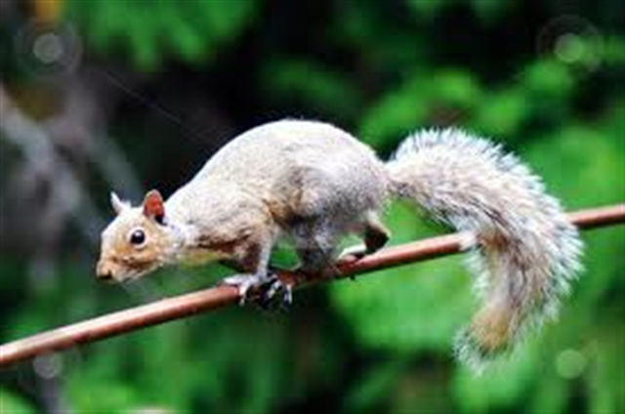
scurrying
To move quickly, often fearfully
The squirrel was scurrying along the branch.

Slide 3
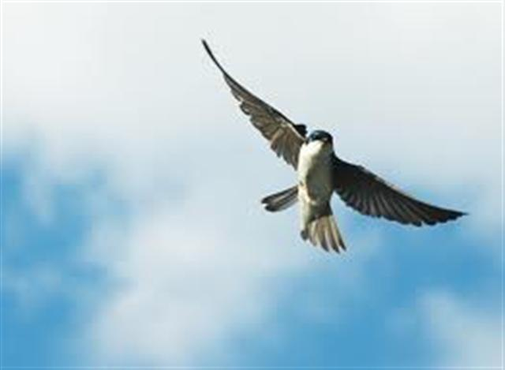
swooped
Move downward really fast especially when attacking something
The bird swooped toward the ground.

Slide 4
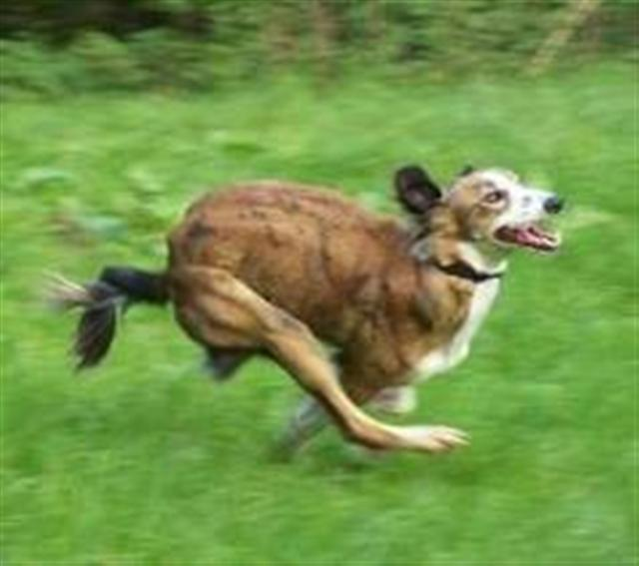
swiftly
Fast; quick; rapid
The dog ran swiftly toward home.

Slide 5
Which picture goes with scurrying?

Slide 6
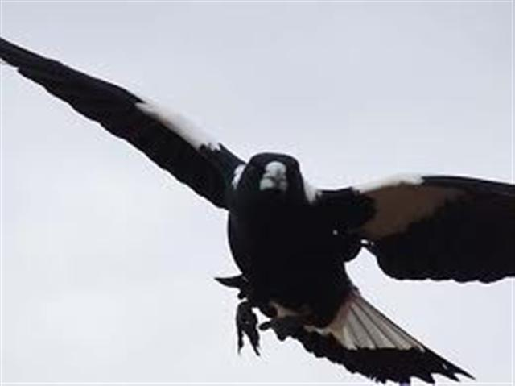
Which picture goes with swooped?

Slide 7
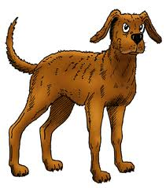
Which picture goes with swiftly?

Slide 8
Which word goes with this picture: scurrying, swooped, or swiftly?

Slide 9
Which word goes with this picture: scurrying, swooped, or swiftly?

Slide 10
Which word goes with this picture: scurrying, swooped, or swiftly?

